Slide 1


Lyme Disease: Case Trends, Climate, and Risk Across the U.S.
Daniel zapata
Nashville software school
Notes:
Today, we’ll discuss Lyme Disease and exploring case trends, the impact of climate change, and risk levels across the United States.

Slide 2
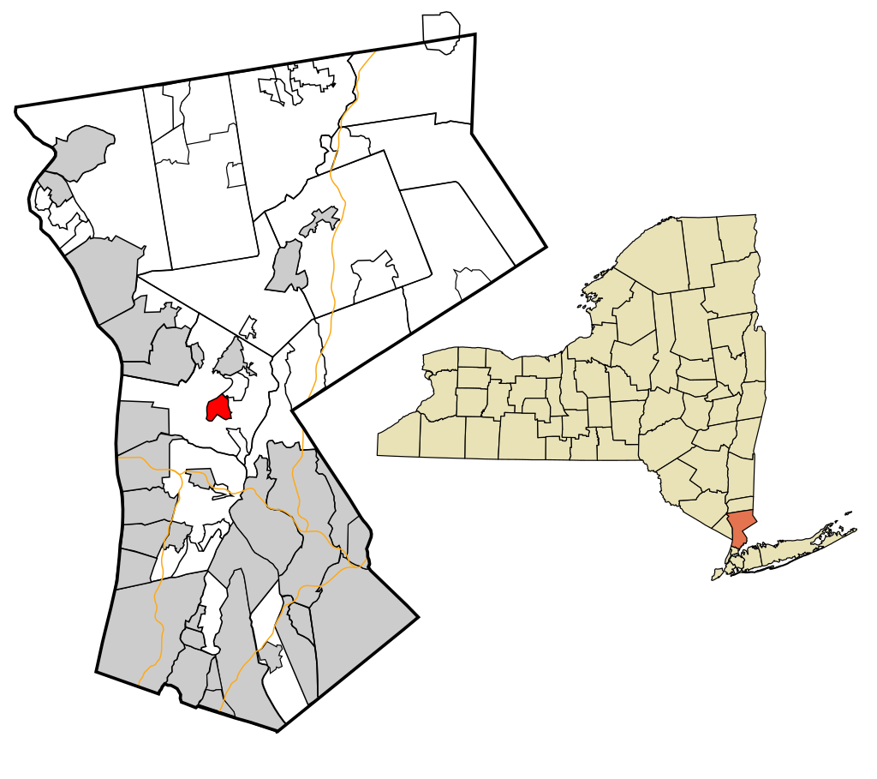
Motivation
01. Grew up in New York
02. Spent time outdoors
03. Road trips across the Northeast
04. Contracted Lyme disease twice
05. Explore risk in Nashville, TN
Notes:
I grew up in New York just 30 miles north of New York City. As a kid, I contracted Lyme disease twice, which we caught early, so I recovered without lasting effects. Then I moved down to Nashville in 2012 and remember being told there really wasn’t any Lyme here, though I never looked into it. This project allowed me to explore whether that claim was actually true or not.

Slide 3




Questions to Explore
How has Lyme disease changed over the past several decades in the United States?
Which states are most affected by Lyme disease and has that changed over time?
Which states have experienced the most significant increase in cases?
Is there a relationship between winter temperatures and case counts?
Does adjusting for population change which states are considered most at risk?
What is the risk of Lyme disease in Tennessee and specifically, Davidson County?
Notes:
I focused on questions like how Lyme disease has evolved over time, what areas of the country are most affected, what effect (if any) has climate change had on cases, and my risk here in Nashville.

Slide 4
Data Sources
Centers for Disease Control and Prevention (CDC)
National Centers for Environmental Information
United States Census Bureau
Case counts by month and year
Case counts by state
Case counts by county
US average monthly temperatures
Regional average temperatures
State average temperatures
US population by year
State populations by year
Tennessee County populations by year
Notes:
To answer these questions I used three main data sources:
The CDC
The National Centers for Environmental Information
And the US Census Bureau
A quick note on the CDC case count data. Although there is federal guidance, policies and surveillance practices vary by state, leading to data limitations. The analysis presented here uses the officially reported surveillance data, which is just one method of tracking Lyme. Other methods suggest the actual number of cases may be significantly higher.

Slide 5
Lyme Disease
Bacterial infection spread through the bite of blacklegged (Ixodes) ticks
Typical symptoms include fever, headache, fatigue, and a skin rash
Treated with antibiotics
Untreated can lead to more severe symptoms
Notes:
So first, a brief overview of Lyme disease. Lyme is a bacterial infection spread to humans via blacklegged tick bites. Symptoms can include fever, headache, fatigue, and a characteristic skin rash. Lyme is highly treatable with antibiotics, even in most later-stage cases. However, untreated infection could spread to the joints, the heart, and the nervous system.
.

Slide 6
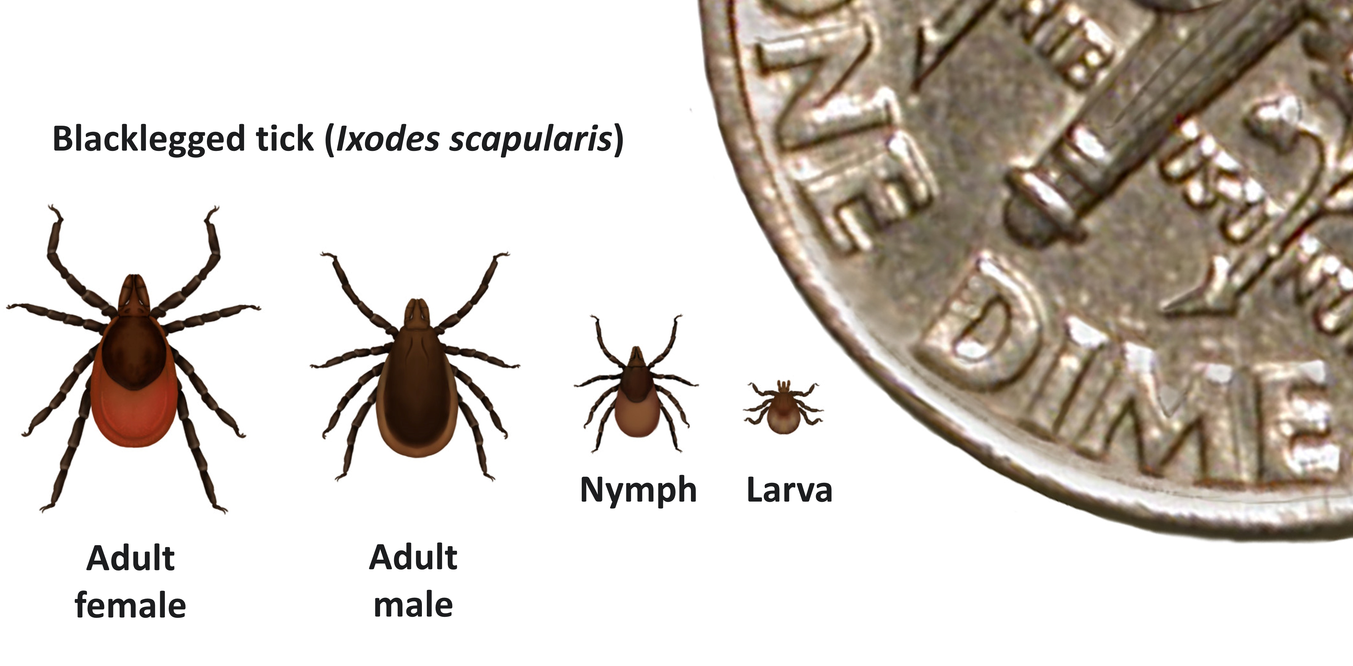
Blacklegged Ticks
Found most commonly in forested areas
2 to 3 year lifespan
4 life stages
Notes:
It’s also important to understand a little bit about the ticks responsible for transmitting the bacteria that causes Lyme disease. Blacklegged ticks are most commonly found in forested areas of the Northeast, north-central, and mid-Atlantic states, with smaller populations along the Pacific Coast. They live 2–3 years and go through four life stages.

Slide 7
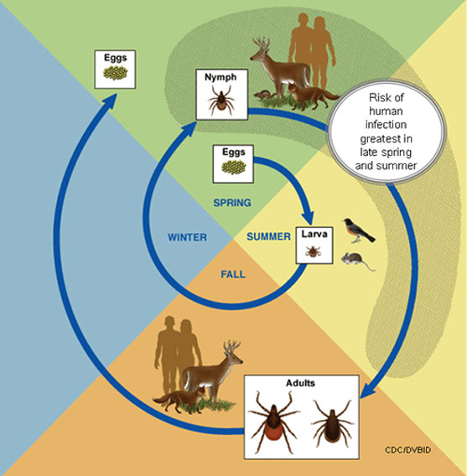
Tick Life Cycle
Require a blood meal
Smaller animals infect the ticks
Must attach for at least 24 hours to transmit
Notes:
Ticks require a blood meal to transition between life stages or produce eggs. It’s during these blood meals the ticks can become infected from animals such as mice. They can then infect future hosts. They go dormant in freezing temperatures and are most active when it's warm.

Slide 8
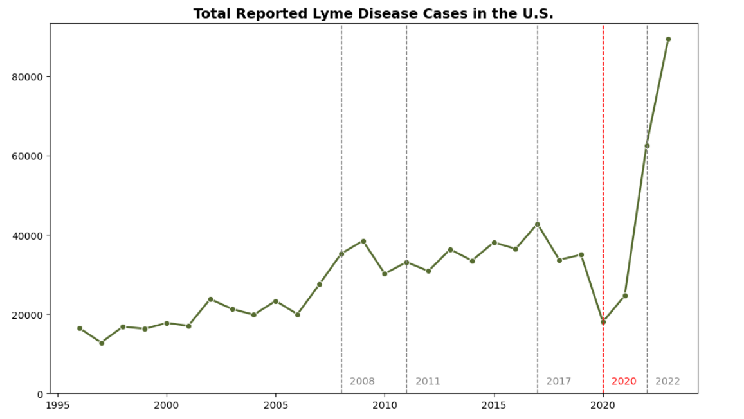
US Case Counts
Notes:
Let’s turn our attention to case trends across the country. Here we see the total number of cases in the US from 1996 to 2023. The dashed lines are years that the case definition for Lyme disease was modified and the red dashed line in 2020 represents COVID. Around this time we see a dip in reported cases, likely due to underreporting from the strained healthcare system. We see case numbers rise again in 2022. This could be due to the reporting behaviors normalizing after a couple of years of COVID as well as a rule change that made it easier for some states to report cases of Lyme. 2023 saw a jump up to about 89,000 cases.

Slide 9
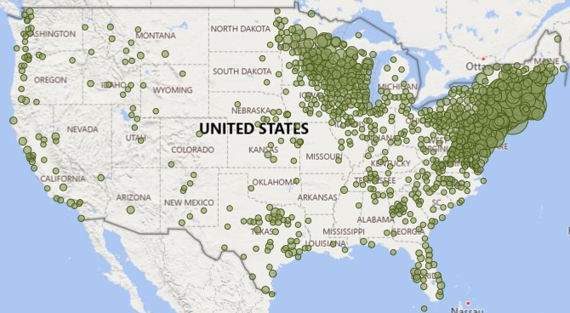
2008
Notes:
We will focus on cases between 2008 and 2023 where state and county level data is most complete. One thing to mention here is that cases are reported based on county of residence, not necessarily county of exposure. This map displays case distribution by county in 2008. Although we see reported cases all across the country, there are some obvious hot zones.

Slide 10
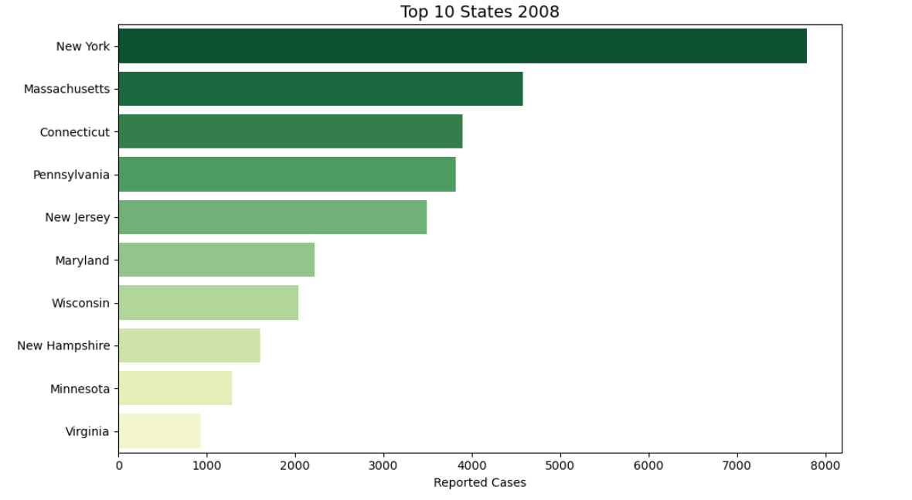
States with the Highest Counts in 2008
Notes:
As expected, based on where blacklegged ticks are most found- Northeastern and north-central states had the highest case counts

Slide 11
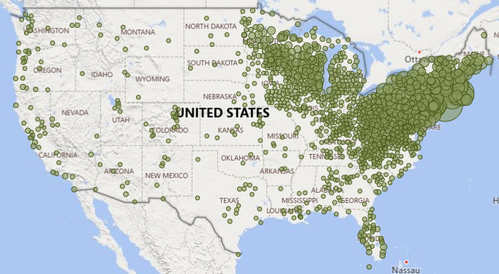
2023
Notes:
Moving forward to 2023- those same hot zones persist, but we also see more cases popping up in the Midwest and southeast. Case counts are rising and spreading geographically.

Slide 12
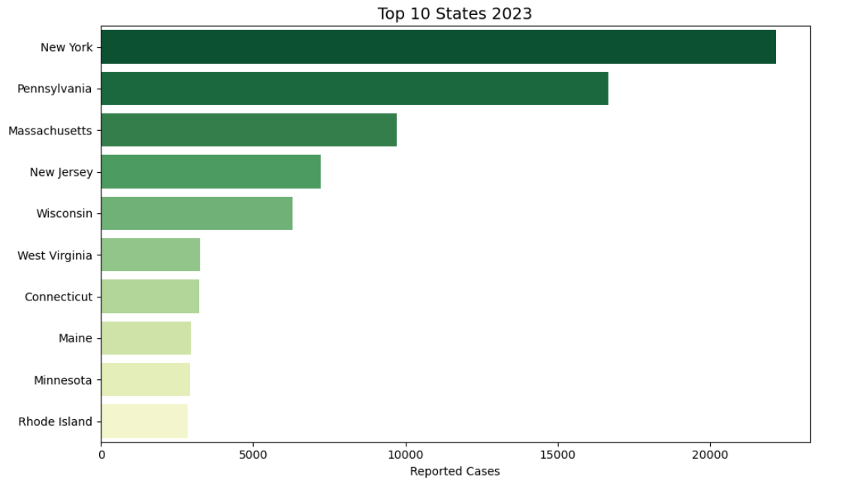
States with the Highest Counts in 2023
Notes:
And when we look at the highest total case counts we’re seeing similar states and regions as in 2008.

Slide 13
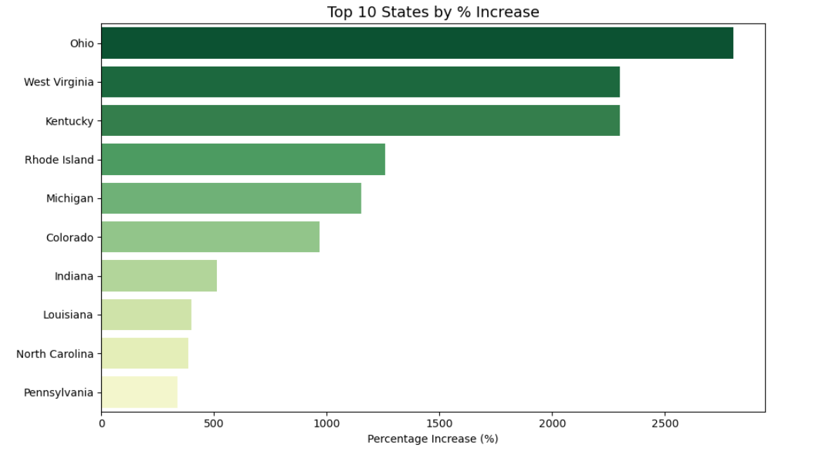
States with the Highest % Increase
Notes:
Nothing too surprising there, but percentage growth tells a different story. Ohio now tops the list rising from 45 cases in 2008 to over 1300 in 2023. West Virginia went from 135 to about 3200.

Slide 14
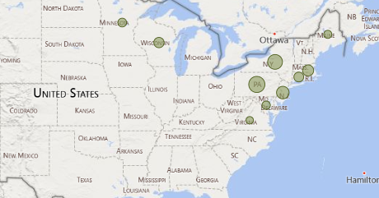
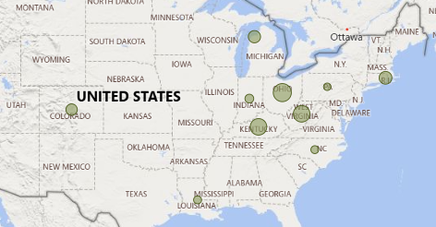
Top 10 States by
Total Cases
Top 10 States by
% Change
Notes:
When we compare total cases vs percentage change, we undoubtedly see that geographic expansion . This made me curious about what factors could be contributing to the growth in some of these states. It was at this point I began to explore how climate change may be impacting Lyme disease.

Slide 15
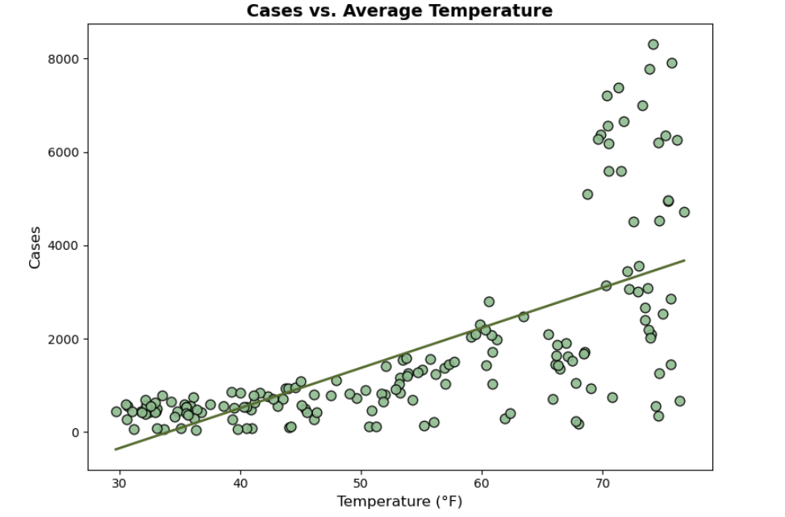
US Cases vs Average Temperature
Notes:
By analyzing total cases of Lyme in the US compared to the average temperature of when those cases are reported, we see a clear positive relationship. Around the freezing point, there are hardly any cases reported, but as the weather warms up, so do the cases. This makes sense since ticks are more active during warmer temperatures- questing for hosts and potentially contracting and spreading bacteria.

Slide 16
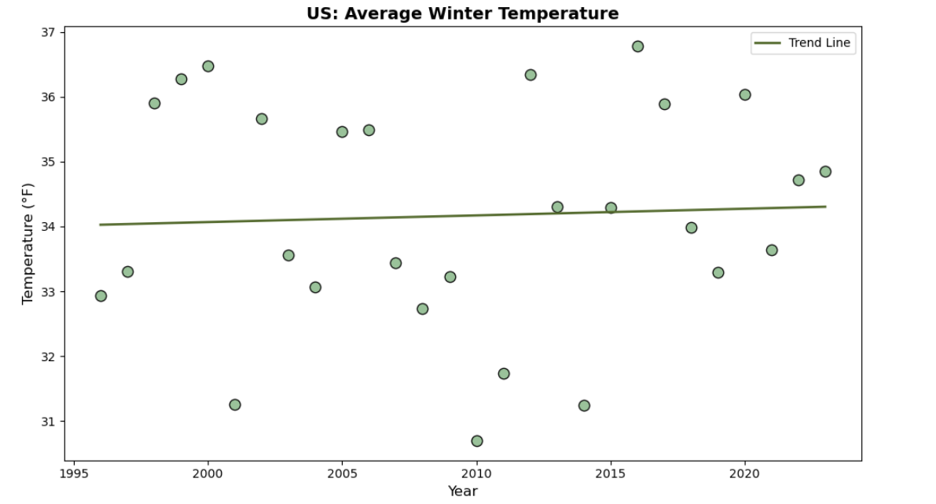
US Average Winter Temperature
Notes:
We know that temperatures are rising globally and from the last graph, we saw most cases occur in warmer months. I figured tick behavior and Lyme cases wouldn’t vary too much during that time, rather I was interested in how winter temperatures impact total annual cases. I designated December, January, and February as “Winter” and calculated the average winter temperature for the US. Here we see evidence of those rising temperatures over time.

Slide 17
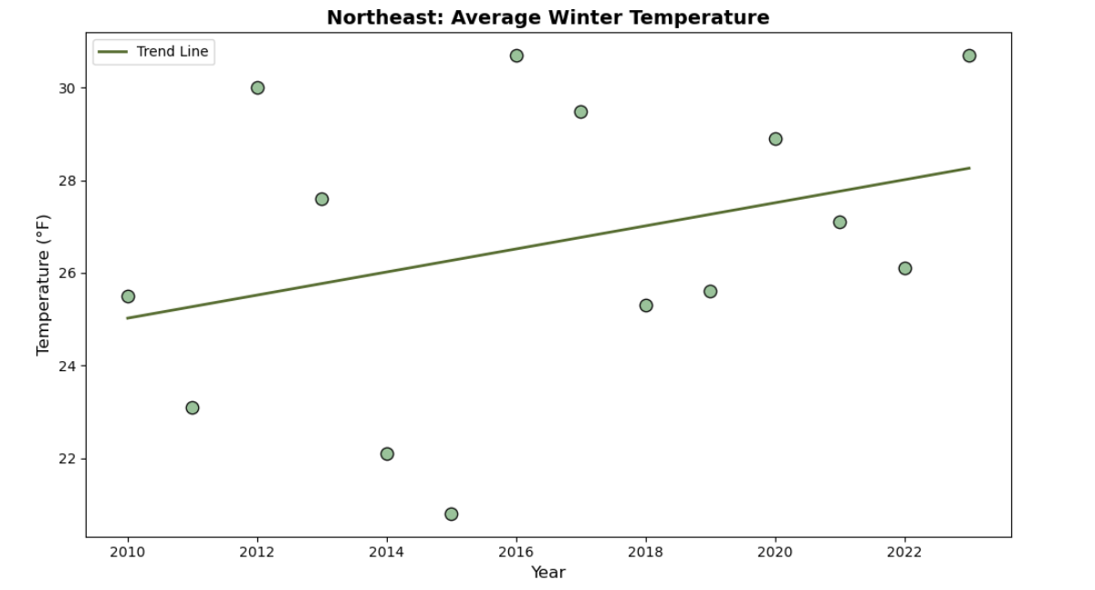
Northeast Average Winter Temperature
Notes:
I first wanted to focus on the Northeast- the region with the most Lyme cases. This graph shows that the average winter temperature is rising.

Slide 18
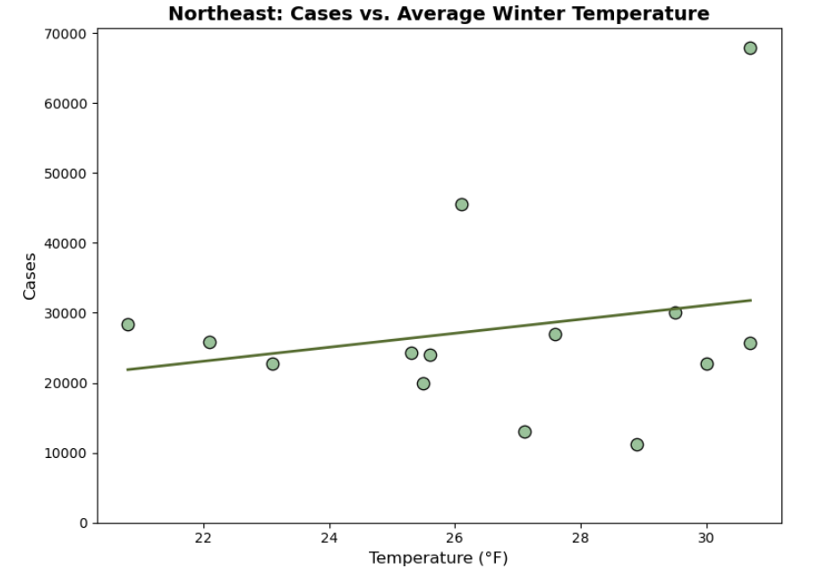
Northeast Cases vs. Average Winter Temperature
Notes:
Comparing case counts with winter temperatures- we see only a slight correlation and I think this is because if you notice on the graph, temperatures average below freezing. Meaning tick activity has remained mostly unchanged.

Slide 19
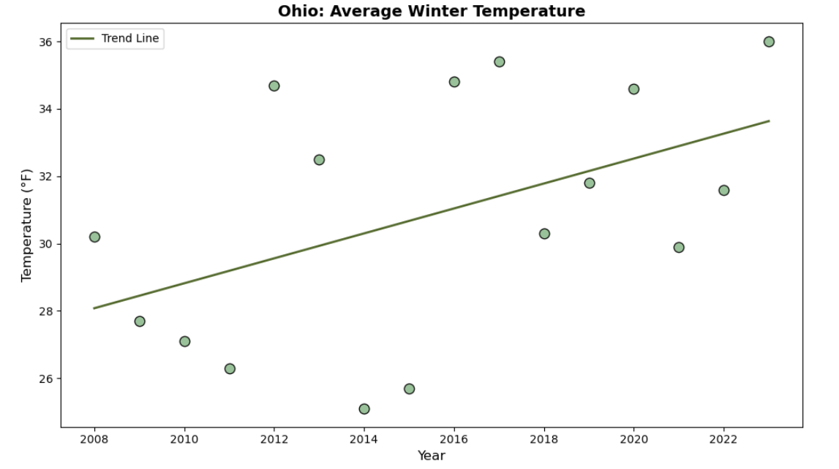
Ohio Average Winter Temperature
Notes:
I then wanted to look at a couple of those states that had the highest percentage change in cases. Here is a graph showing the change in winter temperature in Ohio. Earlier winters were below freezing, but over time they started to hover at or above it.

Slide 20
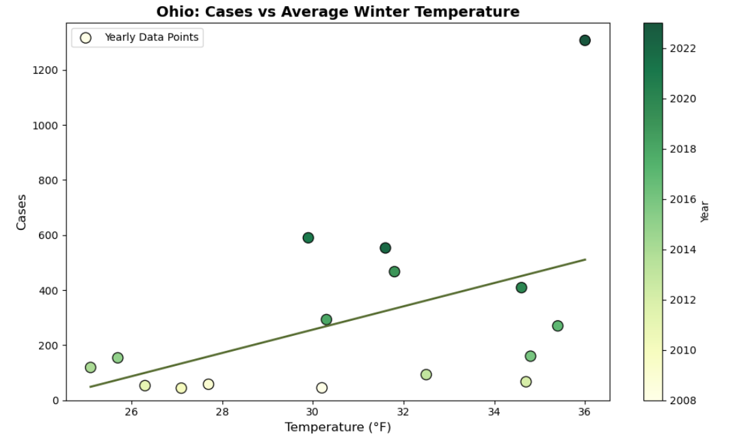
Ohio Cases vs. Average Winter Temperature
Notes:
This graph displays the relationship between winter temperature and case count. We see a stronger relationship here than in the Northeast-as winter temps rise, so do case counts—both trending upward over the past 15 years.

Slide 21
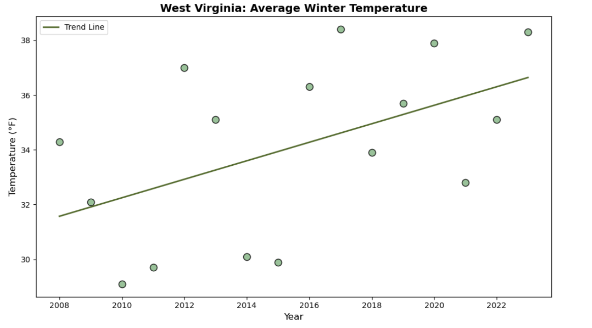
West Virginia Average Winter Temperature
Notes:
Following that, we’ll examine at West Virginia. Here too, average winter temperatures on the rise.

Slide 22
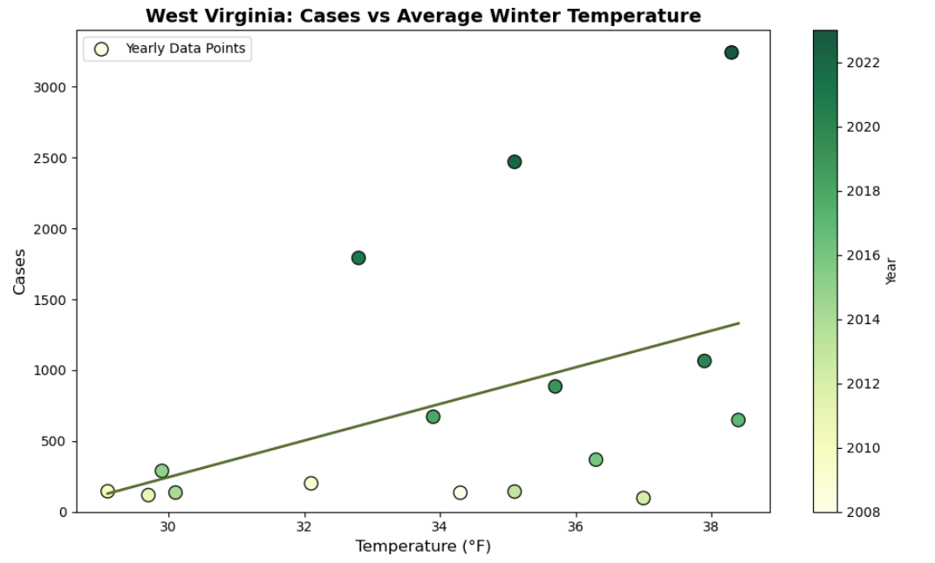
West Virginia Cases vs. Average Winter Temperature
Notes:
And as with Ohio, we’re again seeing a positive relationship between winter temps and cases. Ticks become active above freezing, so warmer winters extend their season and potential to spread disease. Previously low-case areas may see more cases as winters warm, especially in these border states right outside of the hot zones. Historically, they have had winters hovering around freezing, but as averages rise and remain above freezing, cases may follow. Something, I think we’re already starting to see here.

Slide 23
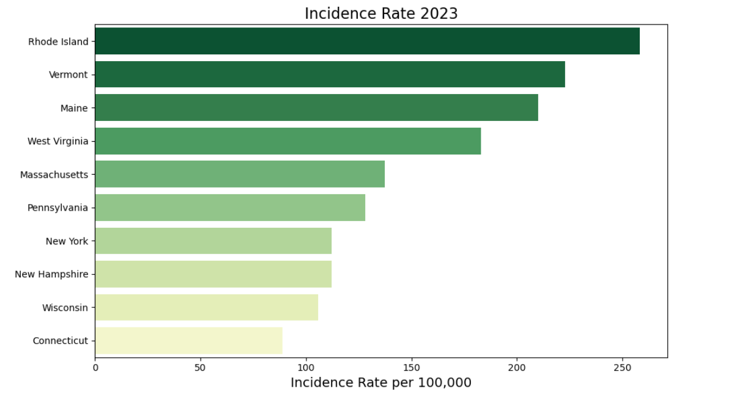
Incidence Rates 2023
Notes:
So far in our analysis, we’ve been looking at trends based on case counts. The number of cases has been growing and spreading, which isn’t an encouraging trend. However, we need to take a step back and factor in population size to get a real idea of risk levels. Looking at the 2023 Incidence Rate, we see that it’s not New York or Pennsylvania, states with the highest case counts, that are most at risk, but actually Rhode Island. It has a rate of about 258 cases per 100,000 people. New York’s is much lower at about 112. And in fact, 6 of the Top 10 states on this list are in New England- making it easily the most at risk region for contracting Lyme

Slide 24
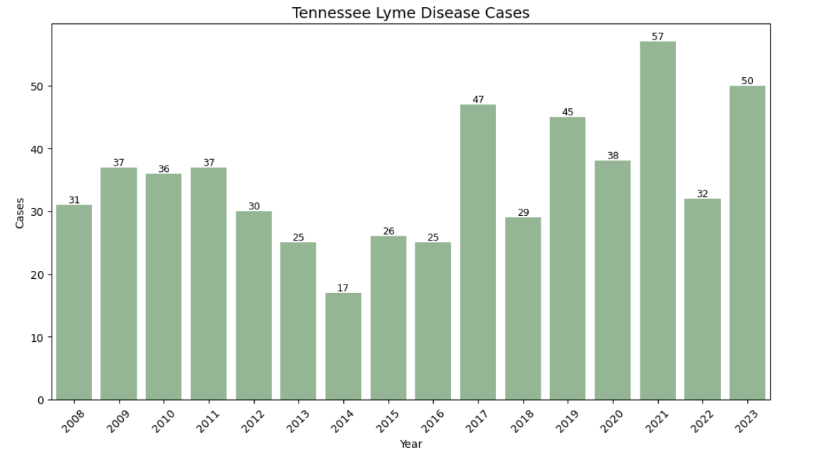
Tennessee Case Counts
Notes:
Fortunately, I live far away from there now, so we’ll turn our attention to Tennessee and assess Lyme risk in Davidson County. Here we see cases across the state have been fairly low since 2008. In 2023, there were only 50 cases across the entire state.

Slide 25
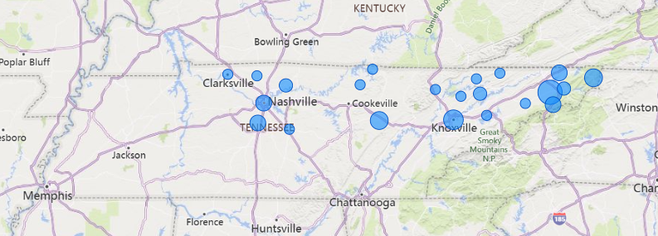
Tennessee Cases 2023
Notes:
Those 50 cases were pretty widespread, but mostly in Middle and East TN.

Slide 26
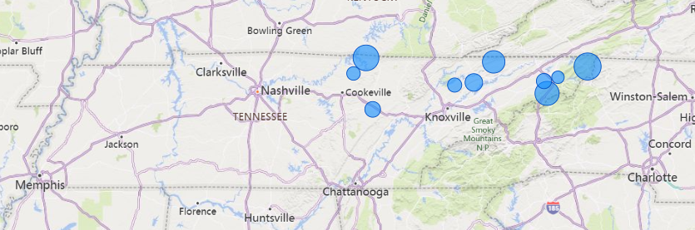
Tennessee County Incidence Rates 2023
Notes:
When we factor in population size, all of the counties with the highest incidence rates are in the northeast corner of the state. Johnson County with the highest rate of about 22 cases per 100,000. However, it’s important to note that it only had 4 total cases reported. We also notice that Davidson county has fallen off the map.

Slide 27
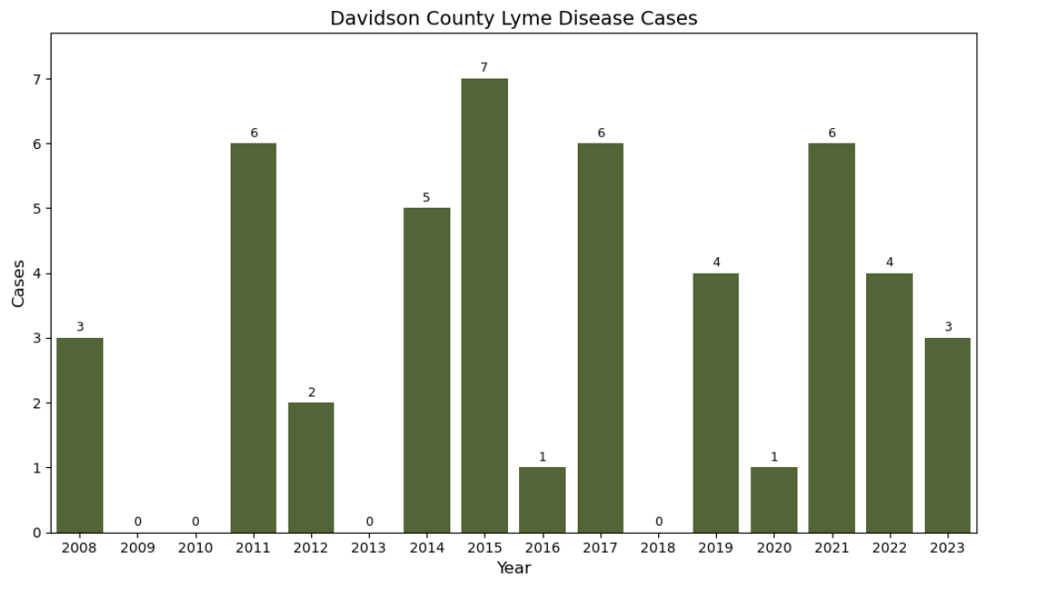
Davidson County Case Counts
Notes:
For a county with over 700,000 residents, there have been very few reported cases of Lyme. Only 3 cases in 2023, which calculates to a rate of .42 cases per 100,000 people. That’s extremely low- almost non existent, and a big relief! I feel fairly confident that I’m not going to contract Lyme here in town at the moment, but as we saw Lyme is spreading and we may see more local cases here in the future.

Slide 28
Opportunities for Further Analysis
Other climate factors
Tick distribution
Behaviors and migration of host animals
Reporting practices
Deforestation
Urban development
Human behavior
Notes:
Doing this analysis, I have learned that climate change is just one piece of the puzzle. There are many variables when it comes to Lyme disease- all worth exploration when evaluating the risk it poses to humans.

Slide 29
Check for ticks!
Be aware of where ticks live
Wear long sleeves and long pants
Wear insect repellent
Check yourself after being outside
Notes:
But for now, I just want to thank you for your time. And if you leave here only remembering one thing - don’t forget to check yourself for ticks!

